Slide 1
Distributed Hash-Breaker Concurrent and distributed Systems AY 2019/20
Filippo Scotto
Luigi Treccozzi

Slide 2

Analisi progetto diapositiva 2
Outline
IMPLEMENTATION
SPECIFICATION
DHB
TEST
TECHNOLOGIES

Slide 3
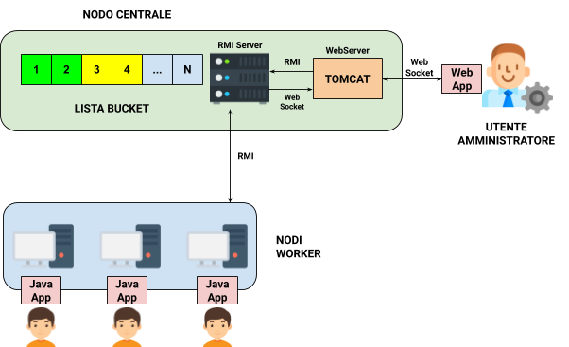
Analisi progetto diapositiva 3
Specifications
DHB is a distributed application that implements an attack on a Hash function, namely SHA-2
It provides an interface through which users can join the attack
The administrator can plan the attack and see the attack progress

Slide 4
Analisi progetto diapositiva 3
Specifications
Administrator: through the WebApp he can launch the attack, provide the plaintext to break, monitor the status of the attack
Workers: Users that want to join the attack. Through GUI they are requested to provide a username
Notes:
(io questa slide la toglierei, tanto è inutile ripetere sempre la stessa roba… La parte relativa alla java app la metterei direttamente nella slide 6 o in una successiva. Stesas cosa per le funzionalità della dashboard che ho emsso nella slide 8)

Slide 5



Analisi progetto diapositiva 3
Used Technologies
JDK-11.0.2 (Swing, RMI)
MAVEN 3.6.1
APACHE TOMCAT 9.0.27

Slide 6
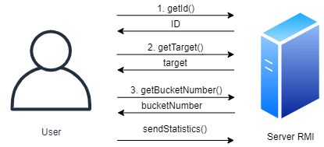
Analisi progetto diapositiva 4
Client-Server Interaction
Java Swing
RMI
Multi-thread
xchart-3.6.0 [1]
[1] https://github.com/knowm/XChart

Slide 7
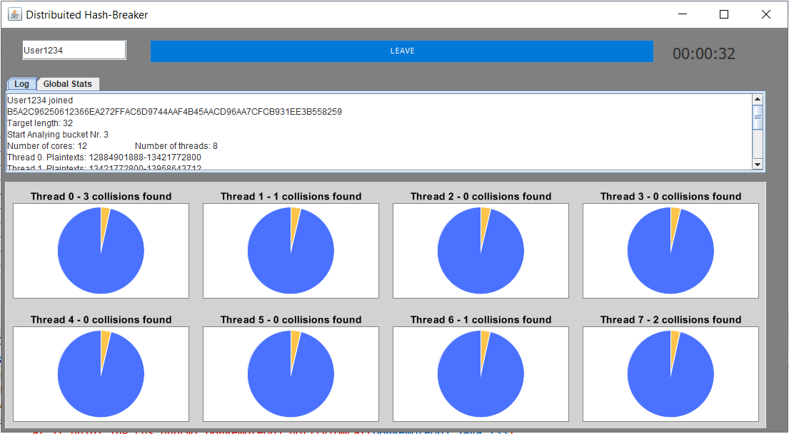
Analisi progetto diapositiva 4
Client-Server Interaction

Slide 8
Analisi progetto diapositiva 4
Client-Server Interaction
When a user joins the attack a bucke is assagned
This bucket is analayzed by various threads, in a number proportional to the number of cores available
Periodically, these threads gather information about their work, and notify these updates to the server
A user can monitor its own state of the attack: number of assigned bucket, percentage of completion, and the collisions that have been found

Slide 9
Analisi progetto diapositiva 4
Server side operations
Server handles a mutual exclusion bucke assignement
Gathers information about the clients that joined the attack and update the statistics accordingly (Statistics thread)
Makes sure that clients no longer active are canceled from the attack and their bucket are revoked and reallocated as free (Guardian thread)

Slide 10
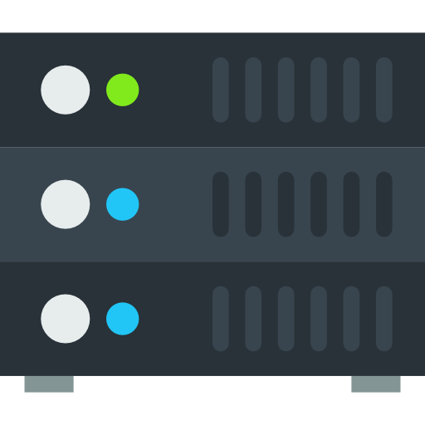

Analisi progetto diapositiva 3
Dashboard and WebServer
Here is presented the overall architecture used to implement the dashboard:
CLIENT SIDE (WEB APP)
WEB SOCKET
SERVER SIDE
WEB SOCKET ENDPOINTS
Planification of a
new attack
Notifications from RMI Server
Plan Attack
Revoke bucket
Updated statistics
WEB SOCKET
RMI
Revoke an allocated
bucket
RMI SERVER
ADMIN
Real time statistics
analysis
CONTEXT
State of the information about the attack progress

Slide 11
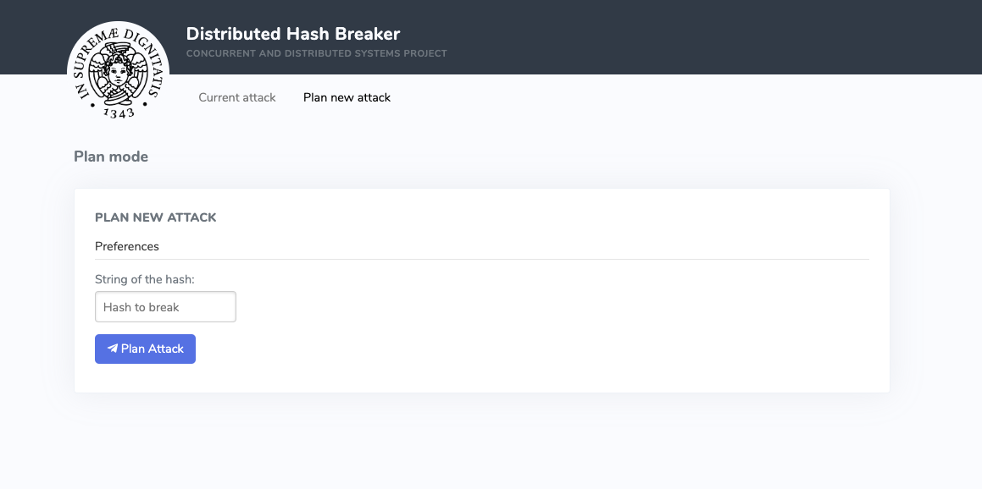
Analisi progetto diapositiva 3
WebApp: Plan an Attack
The plaintext
to break
Once the system is ready, the first thing to do is planning the attack

Slide 12
Analisi progetto diapositiva 3
WebApp: Plan an Attack
Once the administrator has decided which plaintext should be attacked, the WebApp sends a
request to the PlanAttackEndpoint using a simple JSON Message. The WebServer will then
ask the RMI Server to prepare a new attack.
{
hash: ‘text’
}
planAttack(hash)
Web App
WEB SOCKET
PlanAttackEndPoint
RMI
RMI SERVER

Slide 13
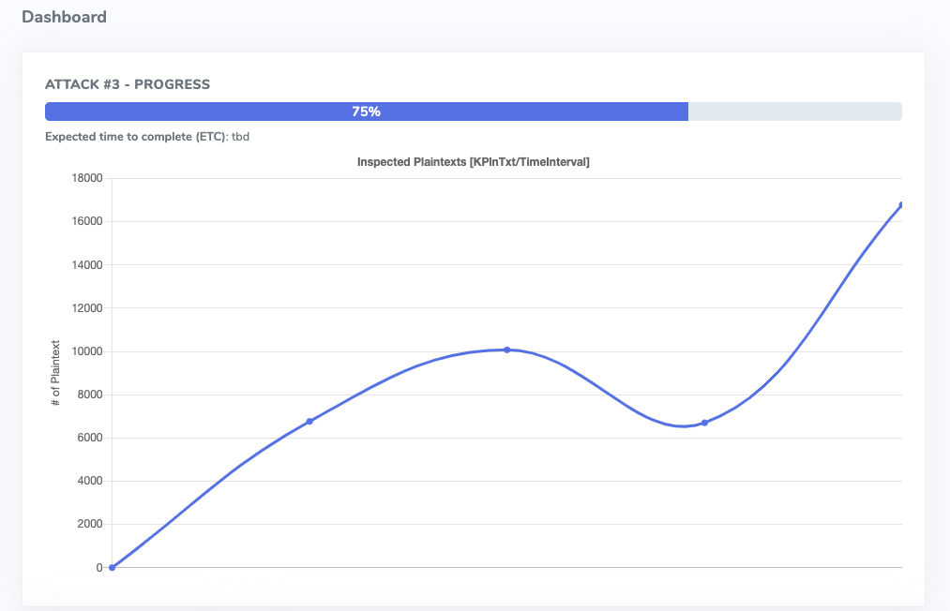
Analisi progetto diapositiva 3
WebApp: Global Statistics
Overall progress
Graph of the number of
Inspected plaintext
Operatively, the administrator can see the global statistics of the attack

Slide 14
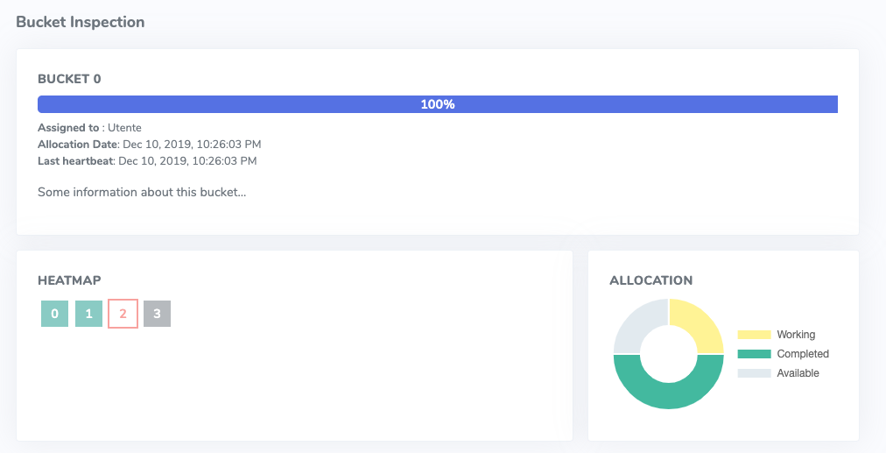
Analisi progetto diapositiva 3
WebApp: Bucket Statistics
Progress for bucket
Info about the user
and last heartbeat
Bucket allocation
chart
Heatmap of the buckets:
Red: low percentage
Yellow: Medium percentage
Green: High percentage
Gray: Not allocated
The administrator can also see the statistics for each allocated bucket

Slide 15
Analisi progetto diapositiva 3
WebApp: Statistics
All the statistics are periodically pushed from the RMI Server (via a dedicated thread) using
the NotifyEndpoint. The state in the context of the WebServer will be modified and the
updates will be eventually propagated to the WebApp using the AttackStatusEndpoint.
{
[’STATS’,
{ … }]
}
{
…
}
NotifyEndPoint
WEB SOCKET
Web App
WEB SOCKET
AttackStatusEndpoint
RMI SERVER

Slide 16
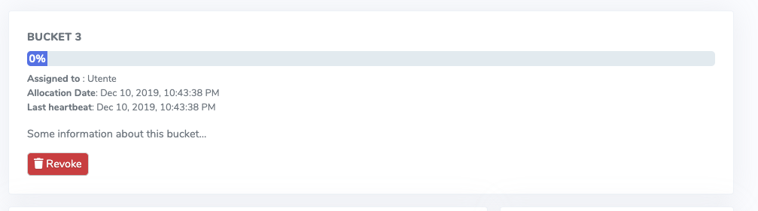
Analisi progetto diapositiva 3
WebApp: Revoke a Bucket
Revoke Button
The administrator can revoke a bucket that was allocated to a certain user

Slide 17
Analisi progetto diapositiva 3
WebApp: Revoke a Bucket
Revoking a bucket is not much different from the previous operations:
{
uuid: ‘id’
}
leave(uuid)
Web App
WEB SOCKET
RevokeBucketEndPoint
RMI
RMI SERVER

Slide 18
Thanks

